Slide 1
Are digital technologies a good or bad thing for archaeology and cultural heritage practice? Dr Sarah Colley Dept. of Archaeology, University of Sydney Federated Archaeological Information Management System Project Stocktaking Workshop UNSW, Sydney, Aug 2012 Plenary Session: Sensitive Data

Slide 2
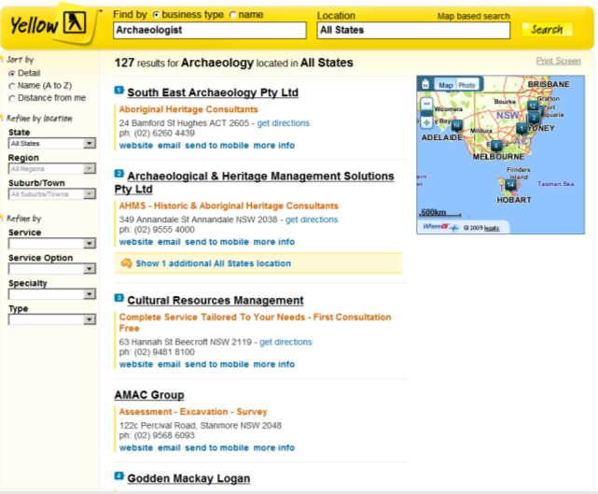
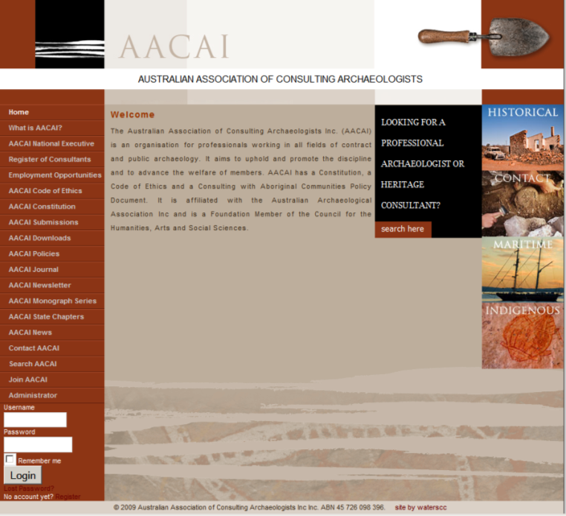
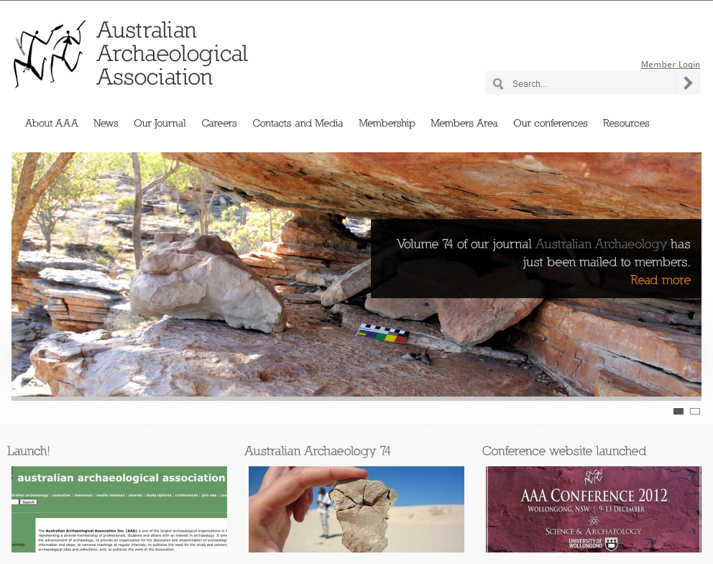
Archaeology is a Profession in Australia (as elsewhere)
but is not formally accredited
Codes of Ethics of Professional Associations

Slide 3
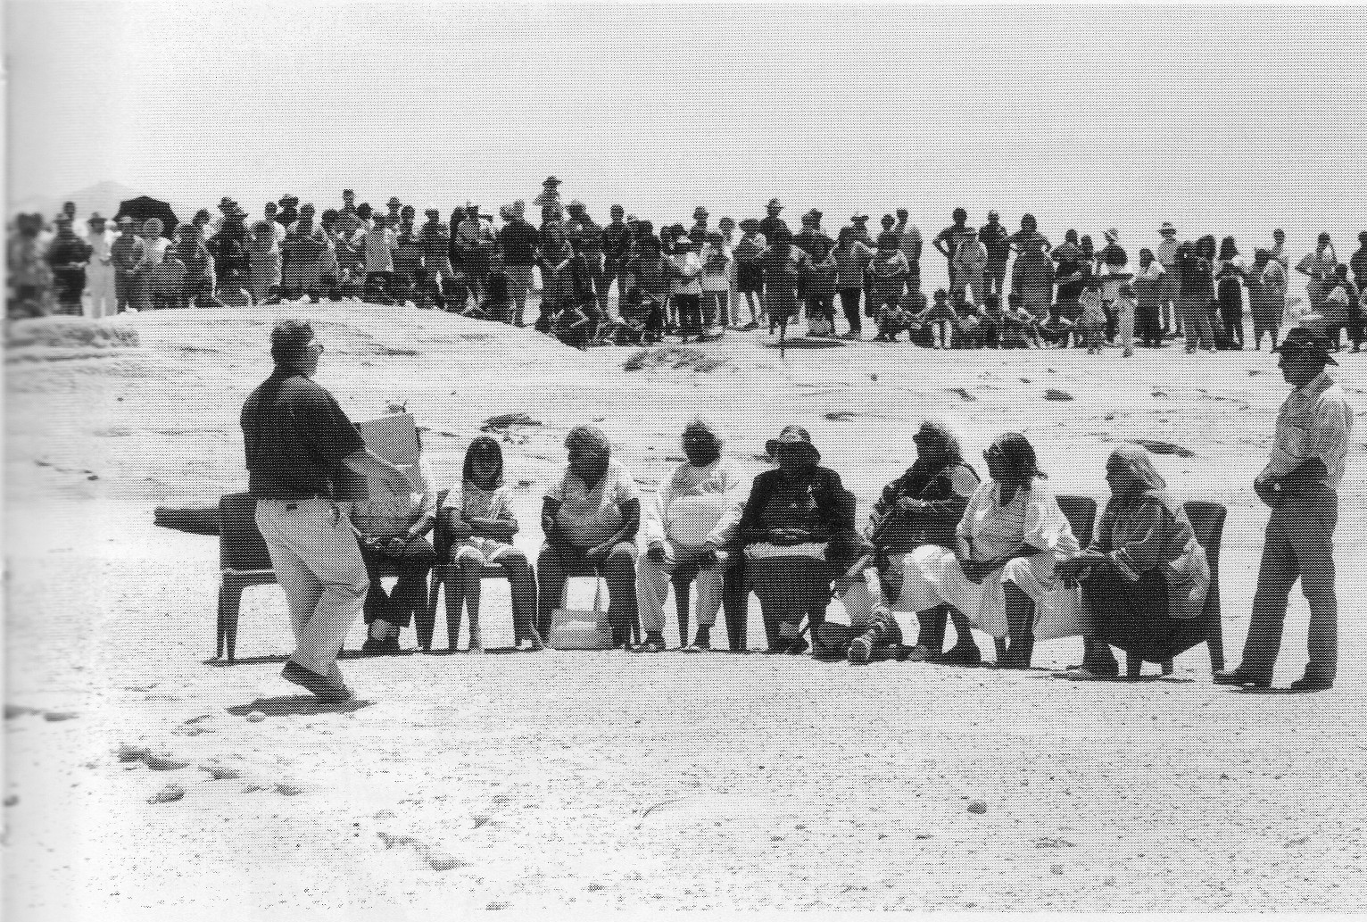
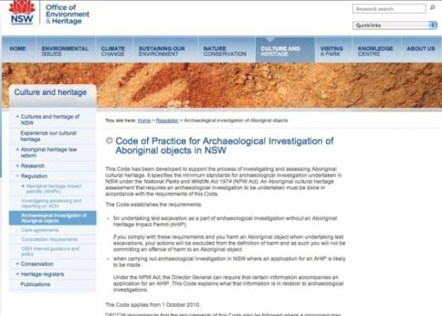
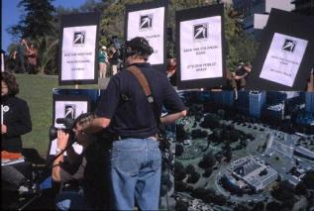
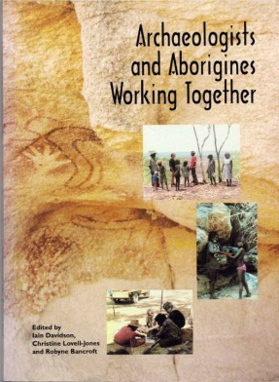
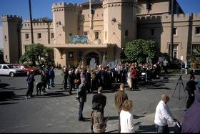
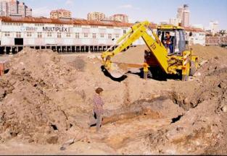
Key Stakeholder Groups in Australian Archaeology
Government Departments and Agencies (Commonwealth, State, Territory & Local)
Heritage Trusts & Historic Properties, Museums
Professional Associations (AAA, ASHA, AIMA, AACAI)
Universities & Research Institutes
Archaeological & Heritage Consultancy Companies
Indigenous Owners & Descendants
Non-Indigenous Descendants
Local History and Heritage Associations, Private Researchers
Tourism and Education Businesses
Media Production Companies & Publishers
Development and Resource Extraction Companies

Slide 4
Archaeological Codes of Ethics Common Themes
rights & responsibilities of professional archaeologists
conservation & ‘stewardship’ of tangible/intangible heritage
rights of key stakeholders/traditional owners
standards for fieldwork & analysis
acknowledge IP, share information, publish
the public ‘right to know’
maintain client confidentiality
act legally

Slide 5
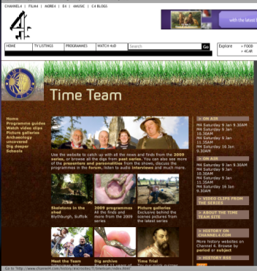
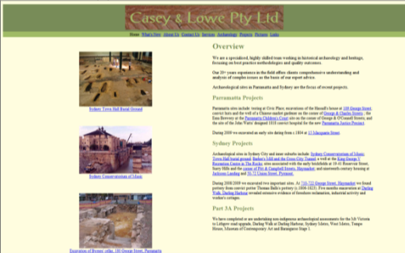
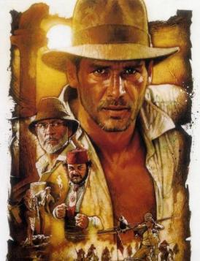
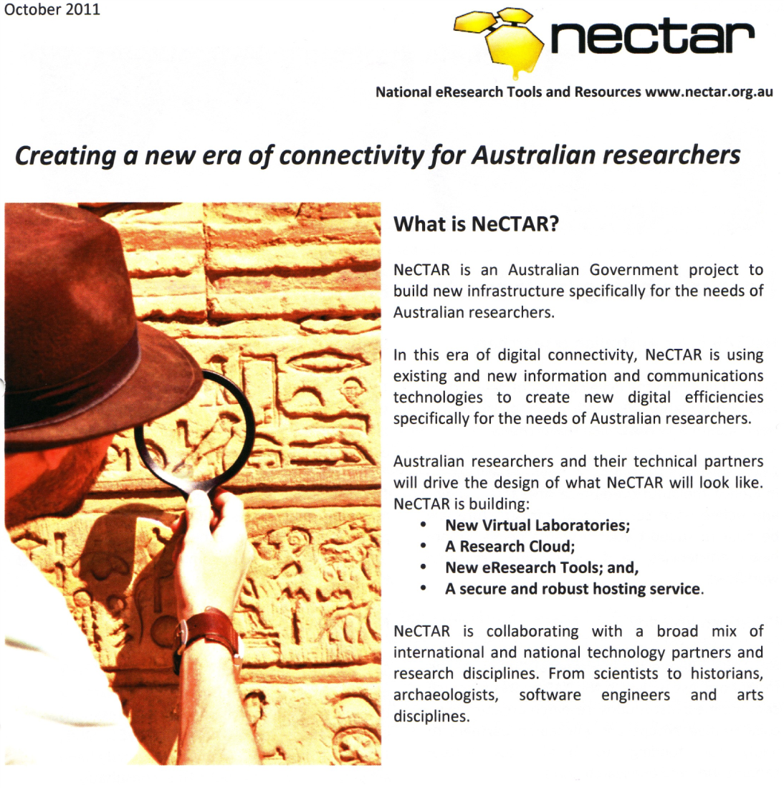
Contested & conflicting values in ethical codes
Unrealistic & unworkable ‘professional’ standards
What is ‘professional’ archaeology? (vs. public/community based). Who is a professional?
Ethical practices are context dependent
Digital technologies present interesting ethical challenges
e.g. Which of these represents ‘real’ archaeology? Does it matter?

Slide 6
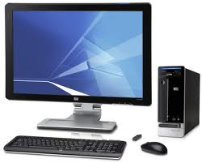
Archaeology, heritage discourses & emerging digital technologies Stage 1 (2009-2012) Pilot Study
Interview survey 2011. 30 archaeologists and heritage practitioners Main workplace in Australia (some archaeology outside Australia)
Work and organisational context?
Type, content and context of communications?
Experiences of working with media professionals?
Use of digital technologies to communicate about archaeology and heritage?
Use of digital technologies to share information?
Benefits and challenges of using digital technologies?

Slide 7
computers & digital technologies ‘Like’
save time, make work easier, quicker, efficient, effective
can store, access & share more information
instant communication, quick online publication
communication with the public, colleagues etc.
“Sexy as hell for presentations”
ease of data analysis
supports new types of analysis
visualize spatial information

Slide 8
computers & digital technologies ‘problems’
limited bandwidth, crashing, outdated hardware and software, need ICT support
poorly designed software (hard to use and remember how to use)
high costs of technology and software, high set-up costs
software and technology that are not interoperable
steep and continual learning curve, constant re-skilling
pressure to produce too much information
“dazzled by technology” that is not needed or useful or can be misleading
technologies are distracting, create expectation of ‘instant replies’ etc
working with people with different levels of digital literacy
digital technologies are a barrier to some kinds of communication
the web is not really ‘democratic’
tangible and hard-copy is sometimes better than digital
sustainability, archiving, costs of metadata entry & data standardisation

Slide 9
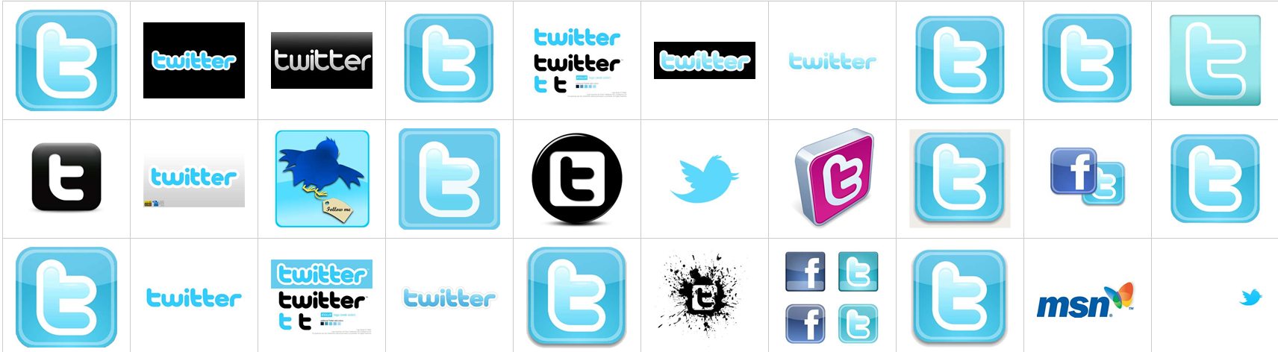
‘social media’ - benefits
Sharing research and influencing an inter-disciplinary research community
Making professional contacts with a very wide range of people
Connecting with students and younger people
“Engaging students better than with Blackboard Learn”
“Flying under the media/marketing people’s radar and circumventing university branding guidelines”
“To communicate with the public”
Make useful professional contacts, advertise work, share information

Slide 10
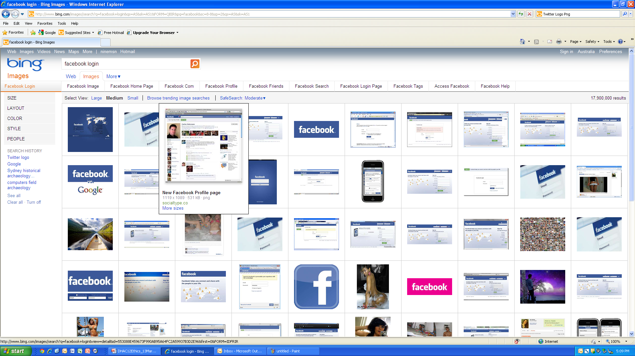
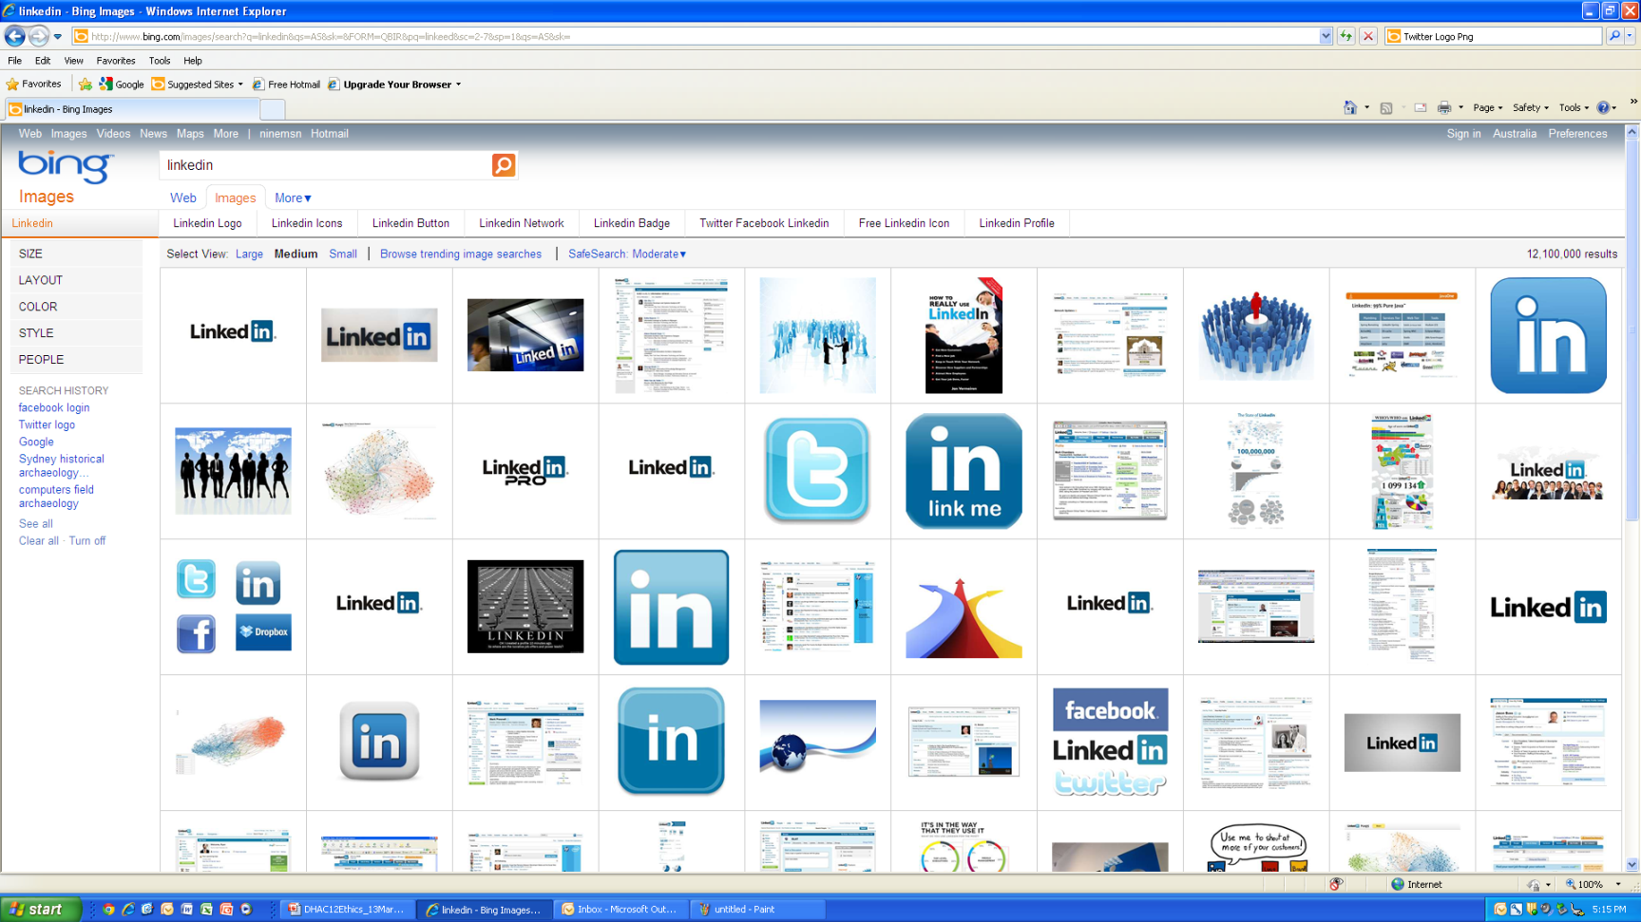
‘social media’ – challenges
“Don’t have much traffic”. “Our company Facebook site was taken down as we didn’t have any Friends and it was a bit embarrassing”
“Very ephemeral. Rather put effort into more permanent medium”
“I’m too old for that”, “Can’t be bothered”, “No I hate them”
“Concerned about things that go wrong with social media”. “I don’t want them to have my personal details”
“Can’t access Facebook from work computers”. “Don’t think the format is suitable for a professional image”
“I’m addicted to Facebook games. You can waste a lot of time.”
“You lose the sense in a truncated Twitter message”.
“Don’t have a mobile phone that supports Twitter”
“I don’t want people to know what I am doing”. “Not allowed to use them by government department”
“Don’t have time (to blog)” “Few people contribute (to wikis)”
“Dealing with negative and derogatory comments”. “People feel they can hide behind anonymity and say things they wouldn’t dare say to your face”

Slide 11
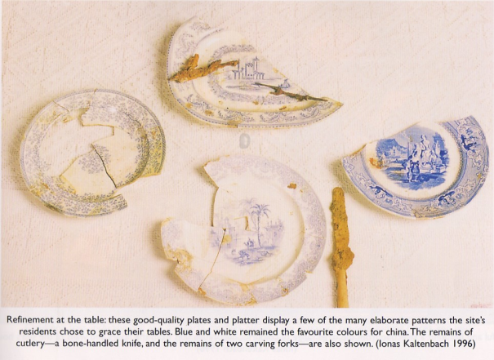
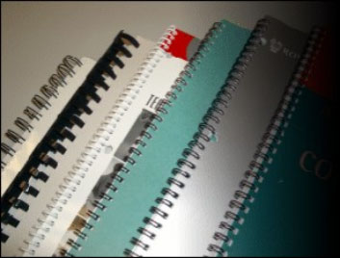
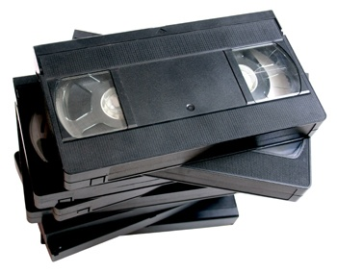

The ‘conservation ethic’ and the digital preservation challenges
Content at risk (without further provision for digital preservation/archiving)
Unpublished consultancy reports (paper, few copies, restricted access)
Other paper-based archives (notes, plans, excavation recording sheets etc)
Photographs on film (negatives, prints, slides)
Content on tape (video, data?)
‘Born digital content’ (text, databases, spreadsheets, GIS shape files, CAD drawings, images, video, multimedia products, websites)

Slide 12
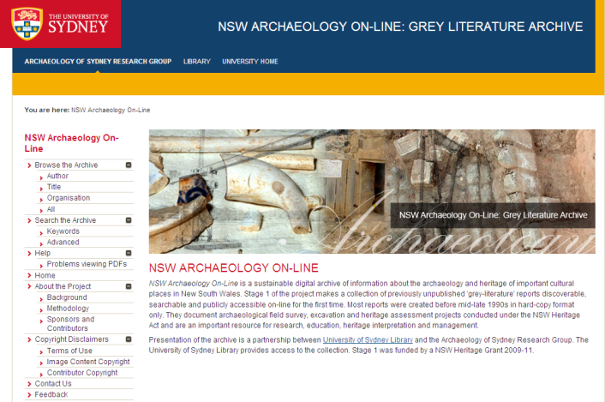
NSW Archaeology Online Stages 1 & 2 (2009-2013)
Sustainable Digital Archive & Search and Presentation Tools
Making unpublished archaeological information discoverable & publicly accessible online and sustainably archived via University of Sydney Library

Slide 13
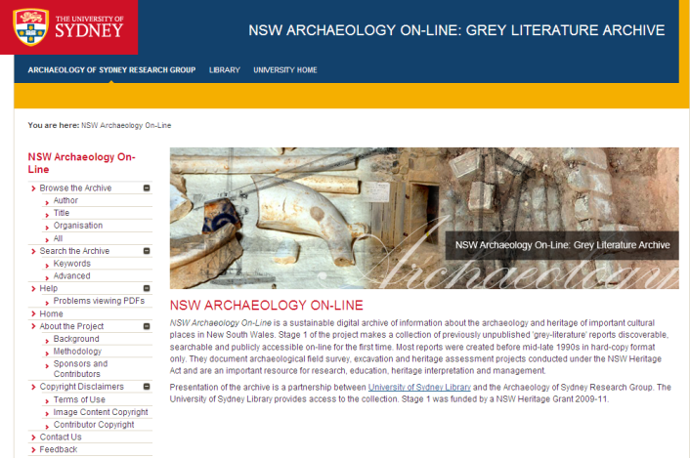


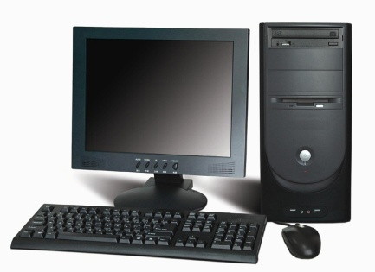





sustainable archive
Web interface (open source) and University of Sydney branding.
University of Sydney Library
eScholarship Repository (DSpace)
Sustainable digital archive
(TIF, PDF, metadata in text formats)
not sustainable (?)
Proprietary software on users’ computers

Slide 14
NSW Archaeology Online ‘Grey-Literature’ - Issues
Making poor quality work public. If low or no research value – why waste resources? Reputational damage? Impact on business? Easy to take things ‘out of context’ from the web.
Sensitive, inappropriate and ‘commercial in confidence’ content? Plagiarism etc. is easily detected by users through OCR/text search.
Costs of IP compliance and obtaining necessary permissions may be prohibitive. University of Sydney adopts ‘risk avoidance’ stance – why should the University take this risk?
Why should consultants provide copies of reports to assist competitors in the heritage industry?
Why should university staff service the heritage industry? Building digital resources does not produce ERA-recognised research outputs.
Vast quantities of data at risk (...and just for NSW historical archaeology...) too much to conduct an audit – and no benefit to NSW AOL staff in doing so...
Why aren’t state governments taking more responsibility for digital preservation/ archiving?
“I’ve scanned my reports to PDF & have thrown the originals away. Can you put the PDFs onto NSW Archaeology Online for me?” Non-sustainable formats/metadata etc. Costs? Whose responsibility is this anyway?

Slide 15
Emerging themes of overall research
more positive than negative attitudes to technology; many challenges and problems
more negative than positive about social media; age significant in attitudes to Facebook
variable levels of digital literacy apparent among respondents
using digital resources effectively to share data needs to be a shared responsibility
professional archaeologists have ethical responsibilities to publish findings & share information with colleagues and the public
designing and using ethical digital technologies effectively involves funding, governance, digital literacy and heritage practice as well as technologies

Slide 16
Acknowledgments
Thanks to
Martin Gibbs (University of Sydney) Co-Director of NSW AOL
Steering Group of Archaeology of Sydney Research Group (Mary Casey, Denis Gojak, Paul Irish, Annie Clarke, Val Attenbrow)
Donors to NSW Archaeology Online Stages 1-2 (Anne Bickford, Ted Higginbotham, Richard Mackay, Wendy Thorpe, Ian Jack, Robert Varman, Judy Birmingham)
NSW AOL Project Assistants Annika Korgaard, Kate da Costa
Mac North, Wayne Johnson, Andrew Wilson
University of Sydney Library (Rowan Brownlee, Sten Christensen, Ross Coleman).
Funding Support
NSW Heritage Council & Department of Conservation & Environment ‘Community Products and Services Grant’ 2009 -2013
University of Sydney, Faculty of Arts, Research Support Scheme Grant 2009.

